Slide 1

CSE523
MACHINE LEARNING PROJECT
PREDICTED BEST XI
Group: Code in Flux
Manasvi Dobariya - AU1841053
Aisha Nagrecha - AU1841137
Dishita Madani - AU1841112
Dhruv Shah - AU1841030

Slide 2


INTRODUCTION
Cricket is one of the most popular sport in the world.
Craze of IPL is all over the world
Popular fantasy leagues like dream11
In fantasy leagues, team of best 11 players from 22 is selected under certain constraints

Slide 3

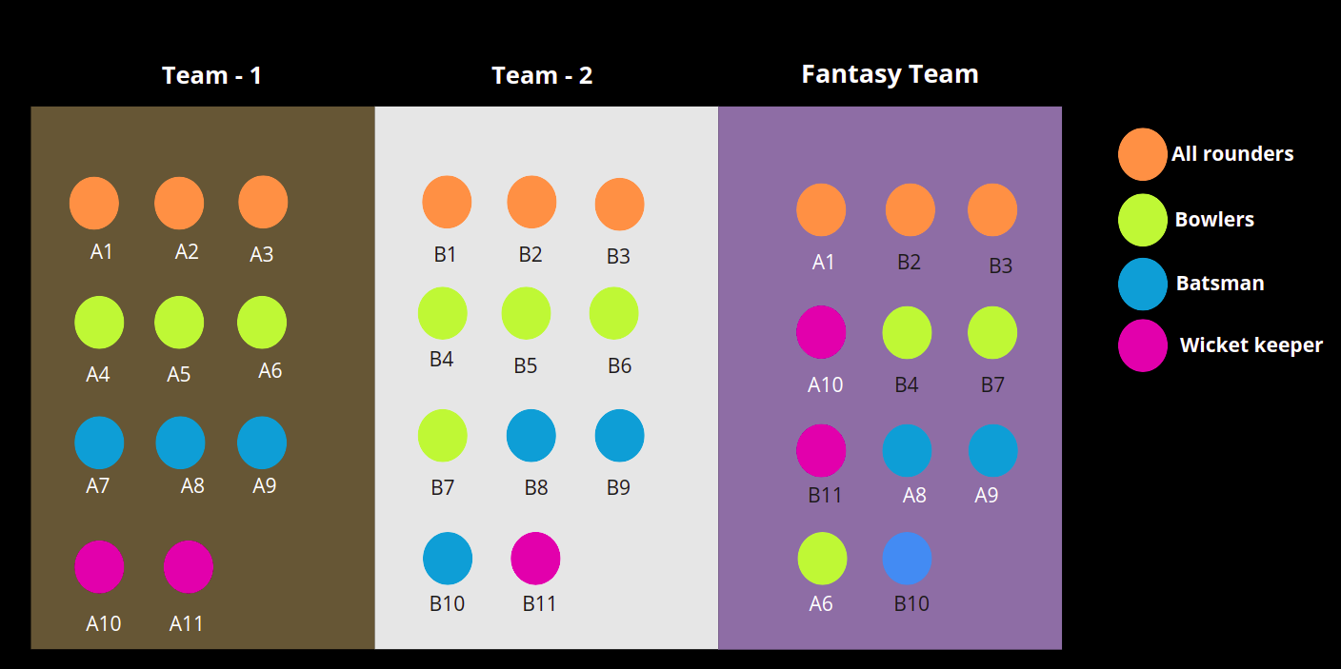


PROBLEM STATEMENT
Predicting the best XI from the combination of playing XI's of both the contesting teams
Determing the best players in an upcoming match

Slide 4
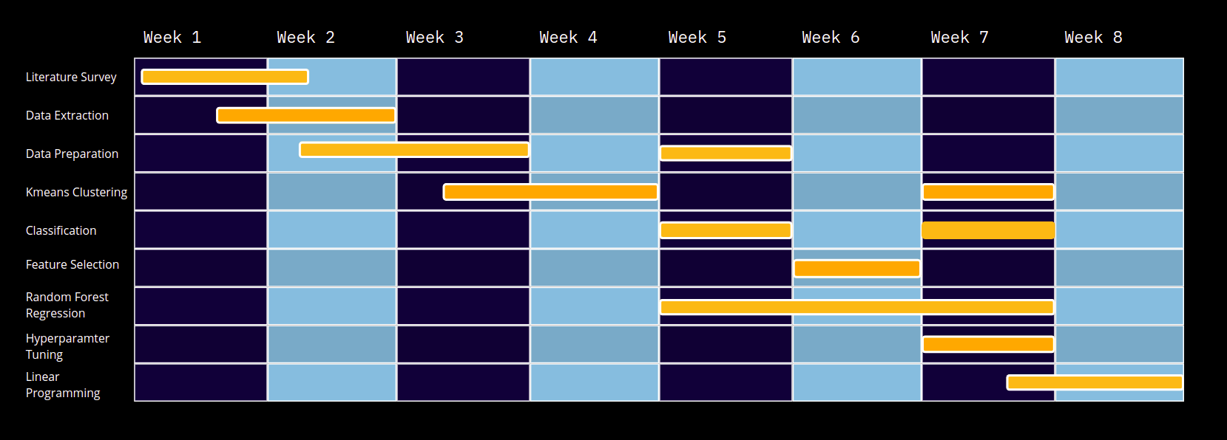
GANTT CHART

Slide 5
EXISTING BODY OF WORK
Initially done using back propagation and radial base network for T20
[2]
Next - using Regression model for ODI
[4]
Using XG Boost, Stacking, Random Forest classifiers and similar complex algorithms to achieve better predictions
[1]

Slide 6
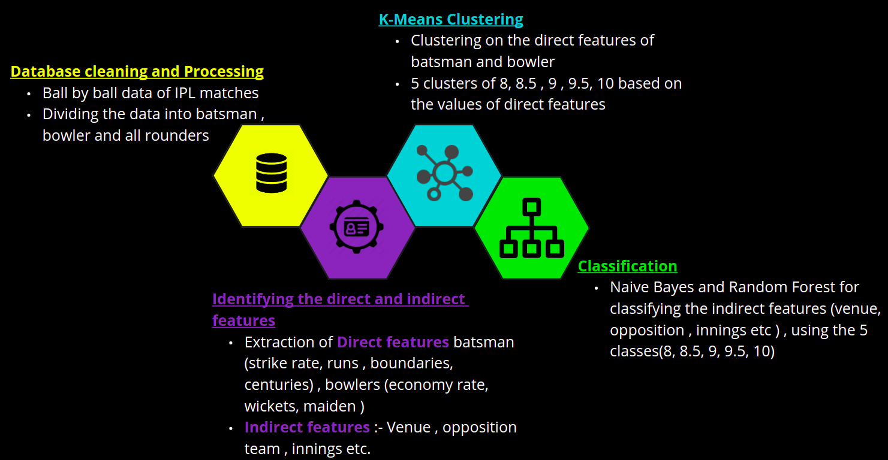
OUR APPROACH

Slide 7
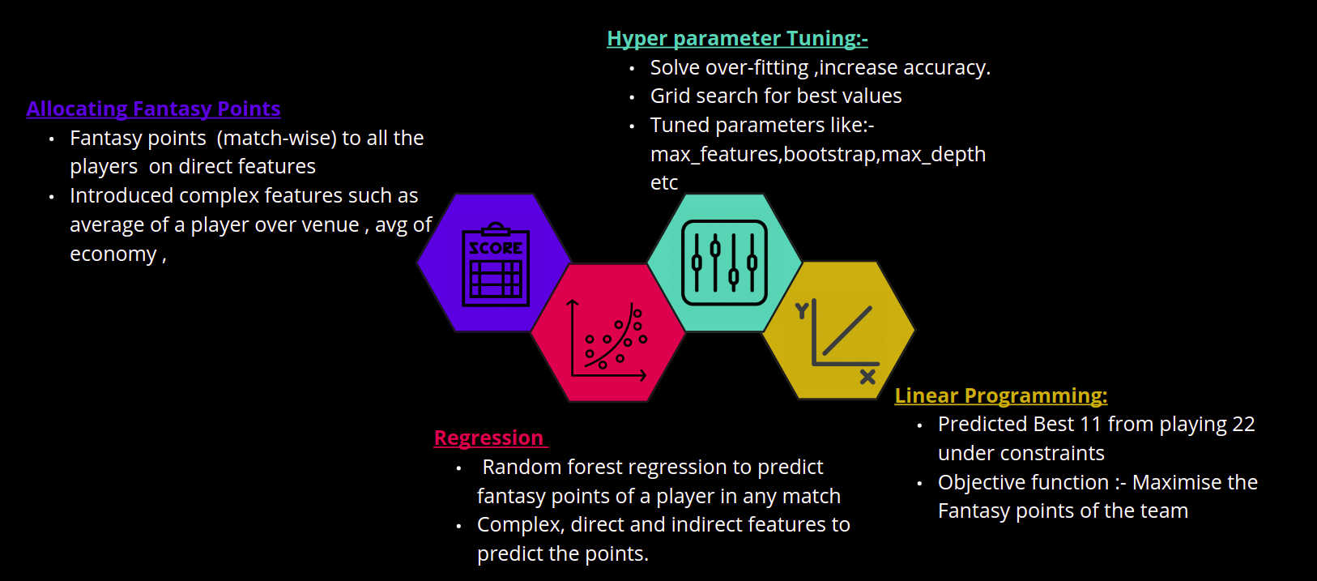
OUR APPROACH

Slide 8
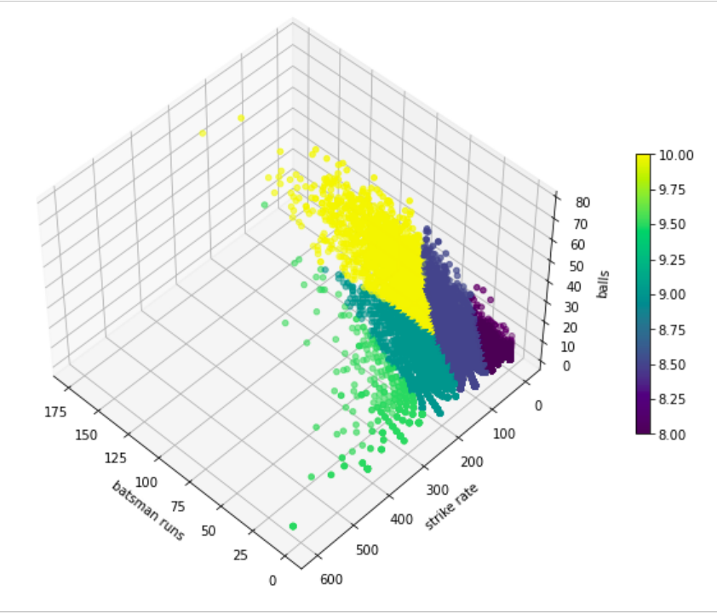
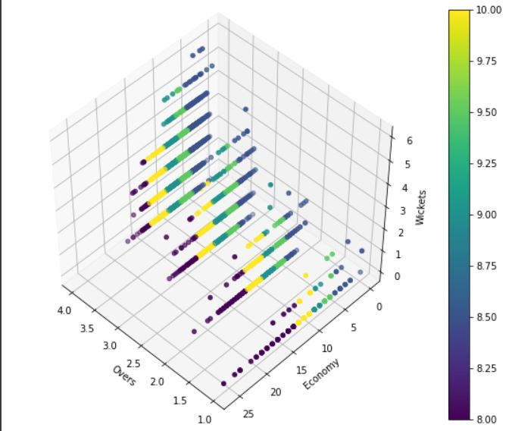
INITIAL RESULTS
Clustering outputs:
Clusters of batsmen
Clusters of bowlers

Slide 9
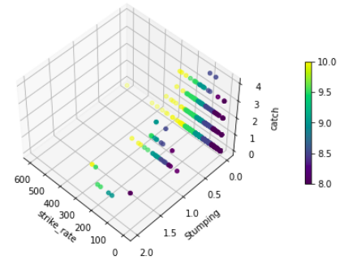
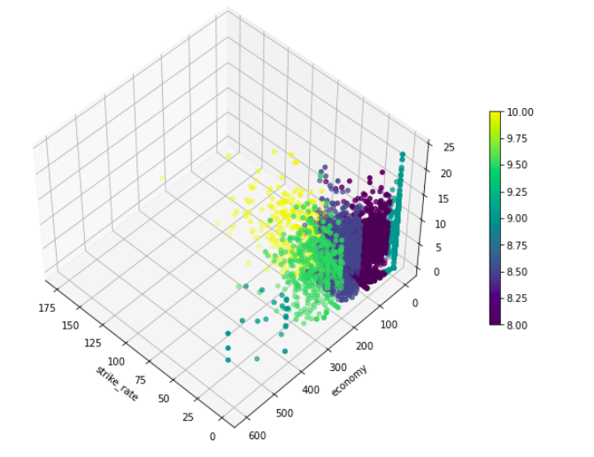
INITIAL RESULTS
Clusters of wicket keeper
Clusters of all rounder

Slide 10
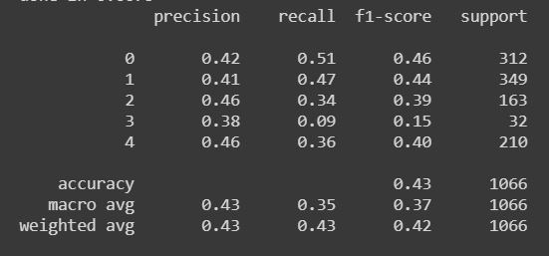
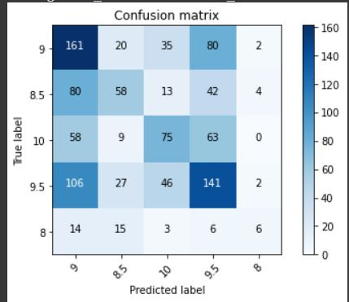
INITIAL RESULTS
Random Forest Classifier
Bowler Classification Report
Confusion Matrix

Slide 11
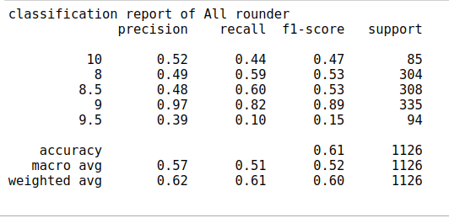
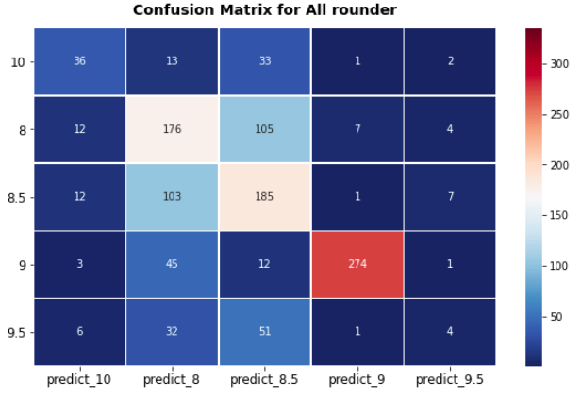
All Rounder Classification Report:
Confusion Matrix:

Slide 12
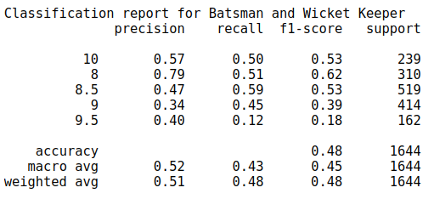
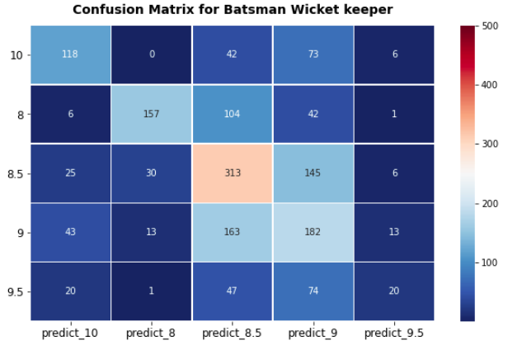
Batsman and Wicket Keeper Classification Report
Confusion Matrix:

Slide 13
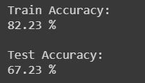
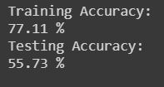
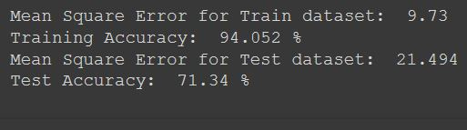
INITIAL RESULTS
Bowler Regression
Batsman Regression
All Rounder Regression

Slide 14
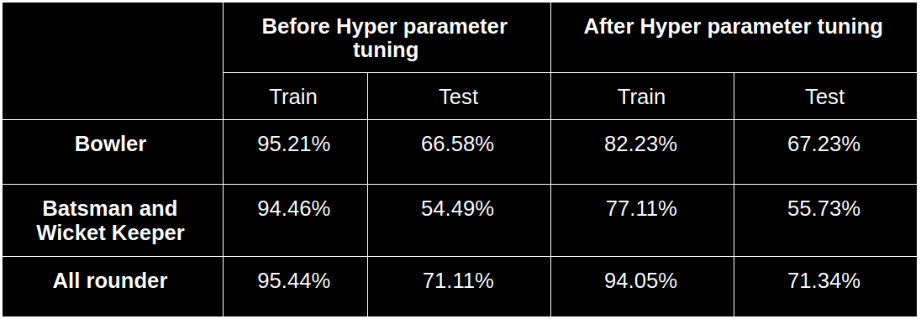
Hyper parameter tuning

Slide 15
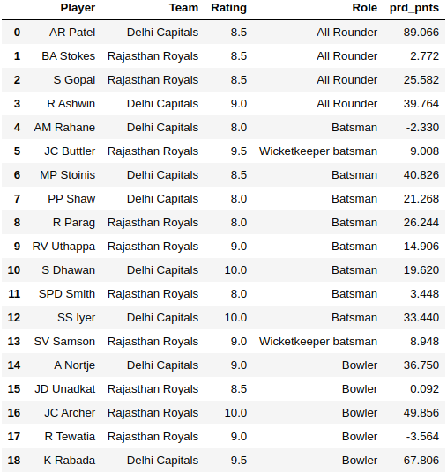
Linear programming
Predict points of each player with regression
Objective function :- Maximize the prd_points(fantasy points)
Apply constraints on choosing players

Slide 16
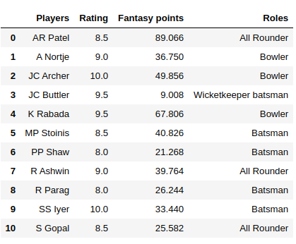
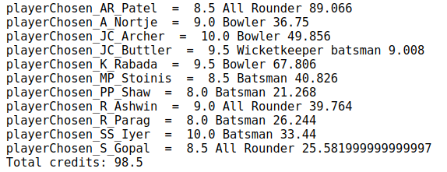
Predicted team:-
Predicted the most optimized team satisfying the objective function and constraints

Slide 17
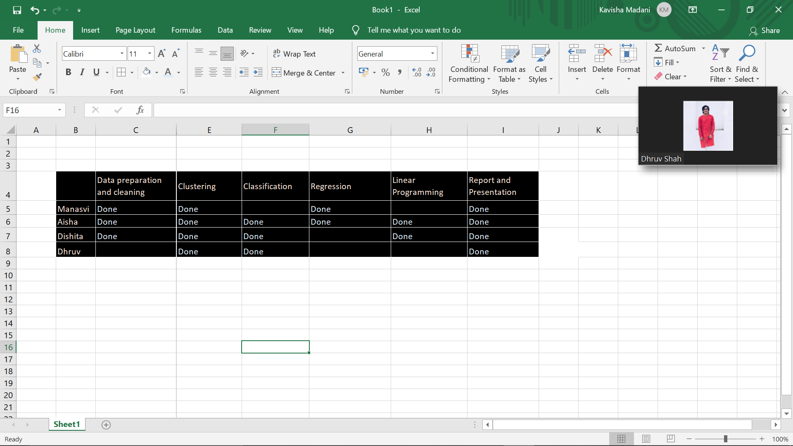
ROLE OF EACH MEMBER

Slide 18
CONCLUSION
Able to get reasonable accuracy
Good results
Can be better - using Deep Learning Techniques

Slide 19
REFERENCES
[1]
Nihal Patel and Mrudang Pandya, “IPL Player’s Performance Prediction”, International Journal of Computer Sciences and Engineering, Volume 7, Issue 5, May-2019, E-ISSN 2347-2693, https://www.ijcseonline.org/pdf_paper_view.php?paper_id=4268&
[2]
Sonu Kumar and Sneha Roy, “Score Prediction and Player Classification Model in the Game of Cricket using Machine Learning”, International Journal of Scientific & Engineering Research, Volume 9, Issue 8, August-2018, ISSN 2229-5518, https://www.ijser.org/researchpaper/Score-Prediction-and-Player-Classification-Model-in-the-Game-of-Cricket-Using-Machine-Learning.pdf

Slide 20
REFERENCES
[3]
Nilesh M. Patil, Bevan H. Sequeira, Neil N. Gonsalves and Abhishek A. Singh, “Cricket Team Prediction Using Machine Learning Techniques”, https://papers.ssrn.com/sol3/papers.cfm?abstract_id=
[4]
Kalpdrum Passi and Niravkumar Pandey, “Predicting Players’ Performance in One Day Internation Cricket Matches Using Machine Learning”, https://airccj.org/CSCP/vol8/csit88310.pdf
[5]
Dataset: https://www.kaggle.com/laxmena/ipl-dataset-2020-season-included

Slide 21
REFERENCES
[6]
Madhav Goswami and Abhishek Anand, “Dream11 Team Predictor with Python and Machine Learning”, https://medium.com/analytics-vidhya/dream11-team-predictor-with-python-and-machine-learning-f0dfce1489eb
[7]
L. Ajay, “Creating a Fantasy Cricket Team - Application of Linear Programming,” Medium, 10-Feb-2021 https://towardsdatascience.com/creating-a-fantasy-cricket-team-application-of-linear-programming-4b60c261702d.

Slide 22
THANK YOU!

